Slide 1

Biogeographical analysis of global deep-sea bottom habitats: using an abiotic province scheme and metazoan occurrence databases
Brandon Michael Genco
Notes:
In thinking about the geographical distributions of living things, I wanted to know: Do seafloor critters abide by the lines and shapes of our maps built on best guesses?

Slide 2
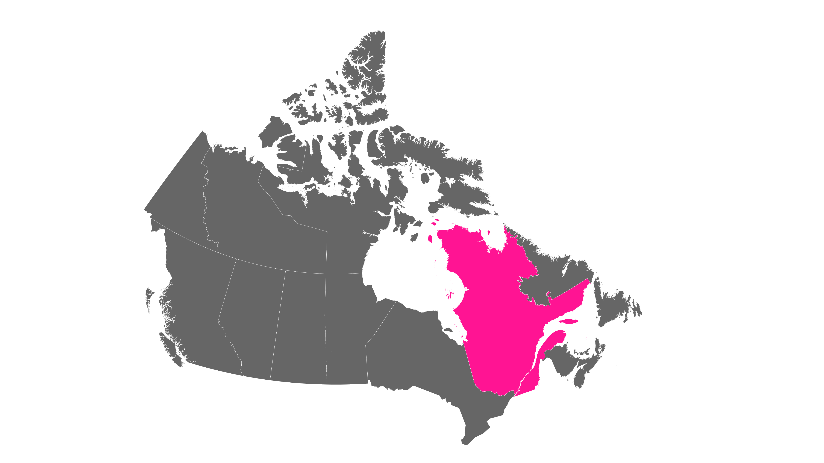

Slide 3
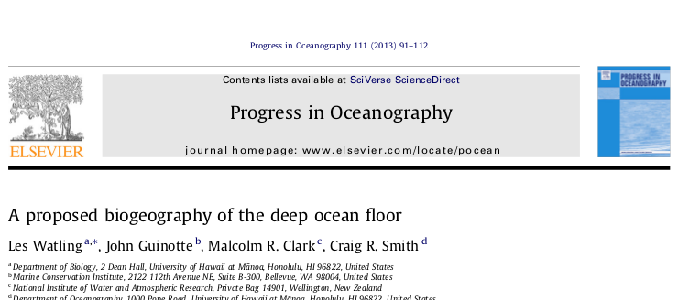
Abiotic Deep-Sea Province Scheme
Physical Variables
1x1km grid cells
Salinity (WOA)
Temperature (WOA)
Oxygen (WOA)
Particulate organic carbon flux (Lutz et al. 2007)
Bathymetery/Depth (Srtm30 Becker et al. 2009)
Watling, Les, John Guinotte, Malcolm R. Clark, and Craig R. Smith. "A proposed biogeography of the deep ocean floor." Progress in Oceanography 111 (2013): 91-112.
Notes:
built upon the GOODS framework, which used previous zoogeographies for delineations as well as unpublished data + expert opion
Aside on Vinogrodova..

Slide 4
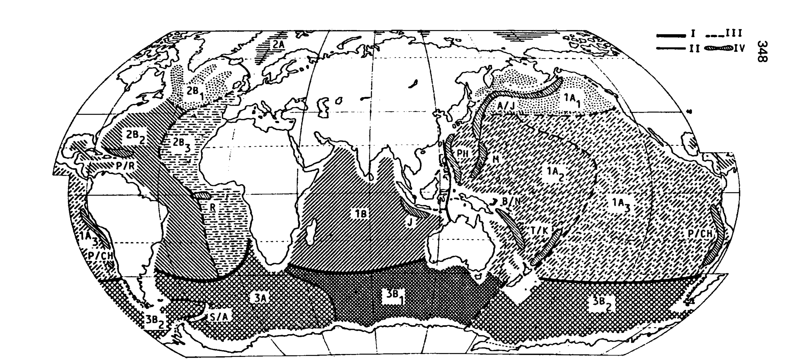
Integration
Deep-sea schemes:
UNESCO. 2009. Global Open Oceans and Deep Seabed (GOODS) - Biogeographic Classification
Menzies et al. (1973)
Kussakin (1973)
Vinogradova (1997)
Belyaev (1989)
Zezina (1997)
Notes:
built upon the GOODS framework, which used previous zoogeographies for delineations as well as unpublished data + expert opion
Aside on Vinogrodova..

Slide 5
Taxa & Delineations
Isopods
Cumaceans
Macrofaunal higher taxa
Protobranch bivalves
Harpacticoid copepods
Polychaetes
Foraminifera
Fishes
Bathyal zones /Continental margins
Topographic and water mass barriers
Basin and subbasin endemicity
POC flux transition zones
Pressure/Depth
Notes:
Watling found cluster of Protobranch bivalves in Atlatinc based on dpeth and basins

Slide 6
Lower Bathyal (800m – 3500m)
Abyssal (3500 – 6500m)
Hadal (6500m +)

Slide 7
Lower Bathyal (800m – 3500m)
Abyssal (3500 – 6500m)
Hadal (6500m +)

Slide 8
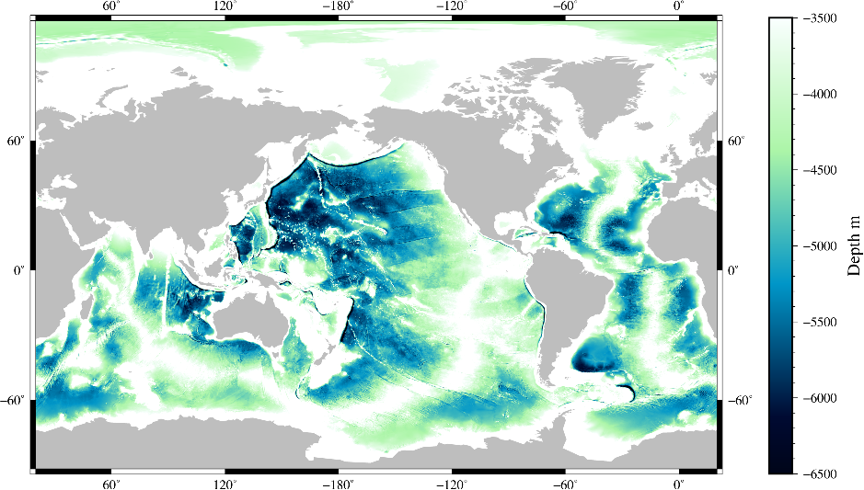
Abyssal Zone (3500m - 6500m)
70.5% of earth’s surface
19 of 27 deep* habitats
* Ramirez-Llondra, E. et al. (2010) Biogeosciences
Notes:
Hadal zones are dominated by trenches,ecosystems that are known to be unique, cover asmall percentage of the ocean floor, exist as discreet units separated by vast distances, and are notconsidered threatened by direct anthropogenic disturbance. Bathyal zones exist primarily on thesteep slopes of the continental margin and mid-ocean ridges, and have complex small habitat scaleheterogeneity, less total area than abyssal systems, and are influenced on both depth boundaries byadjacent contrasting zonal ecosystems. The abyssal systems were chosen as representative of theopen ocean, which lack confounding factors for analysis.

Slide 9
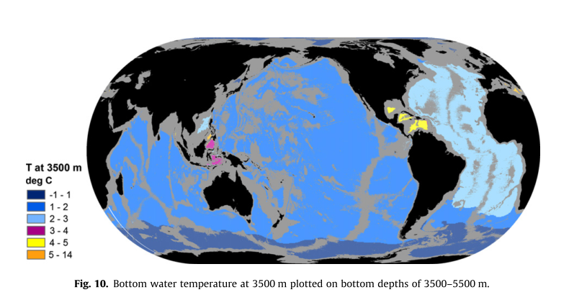
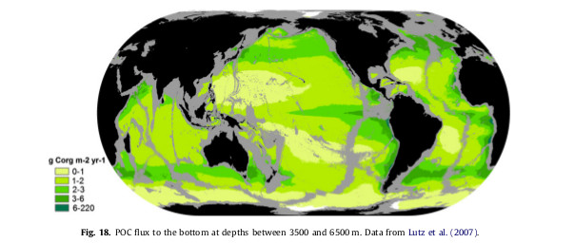
Notes:
Slainit and temeprature for water mass profilkes
Slainilt below 3500m reatilvekly stabel, variation can be use to trace
North Atlantic Deep water
Arctic Deeop water (ABBW
Antarctic Bottom Water AABW)
rrcumpolar deepwater

Slide 10
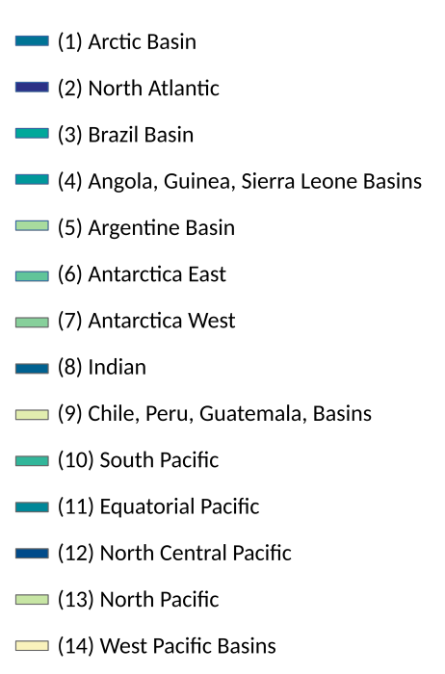
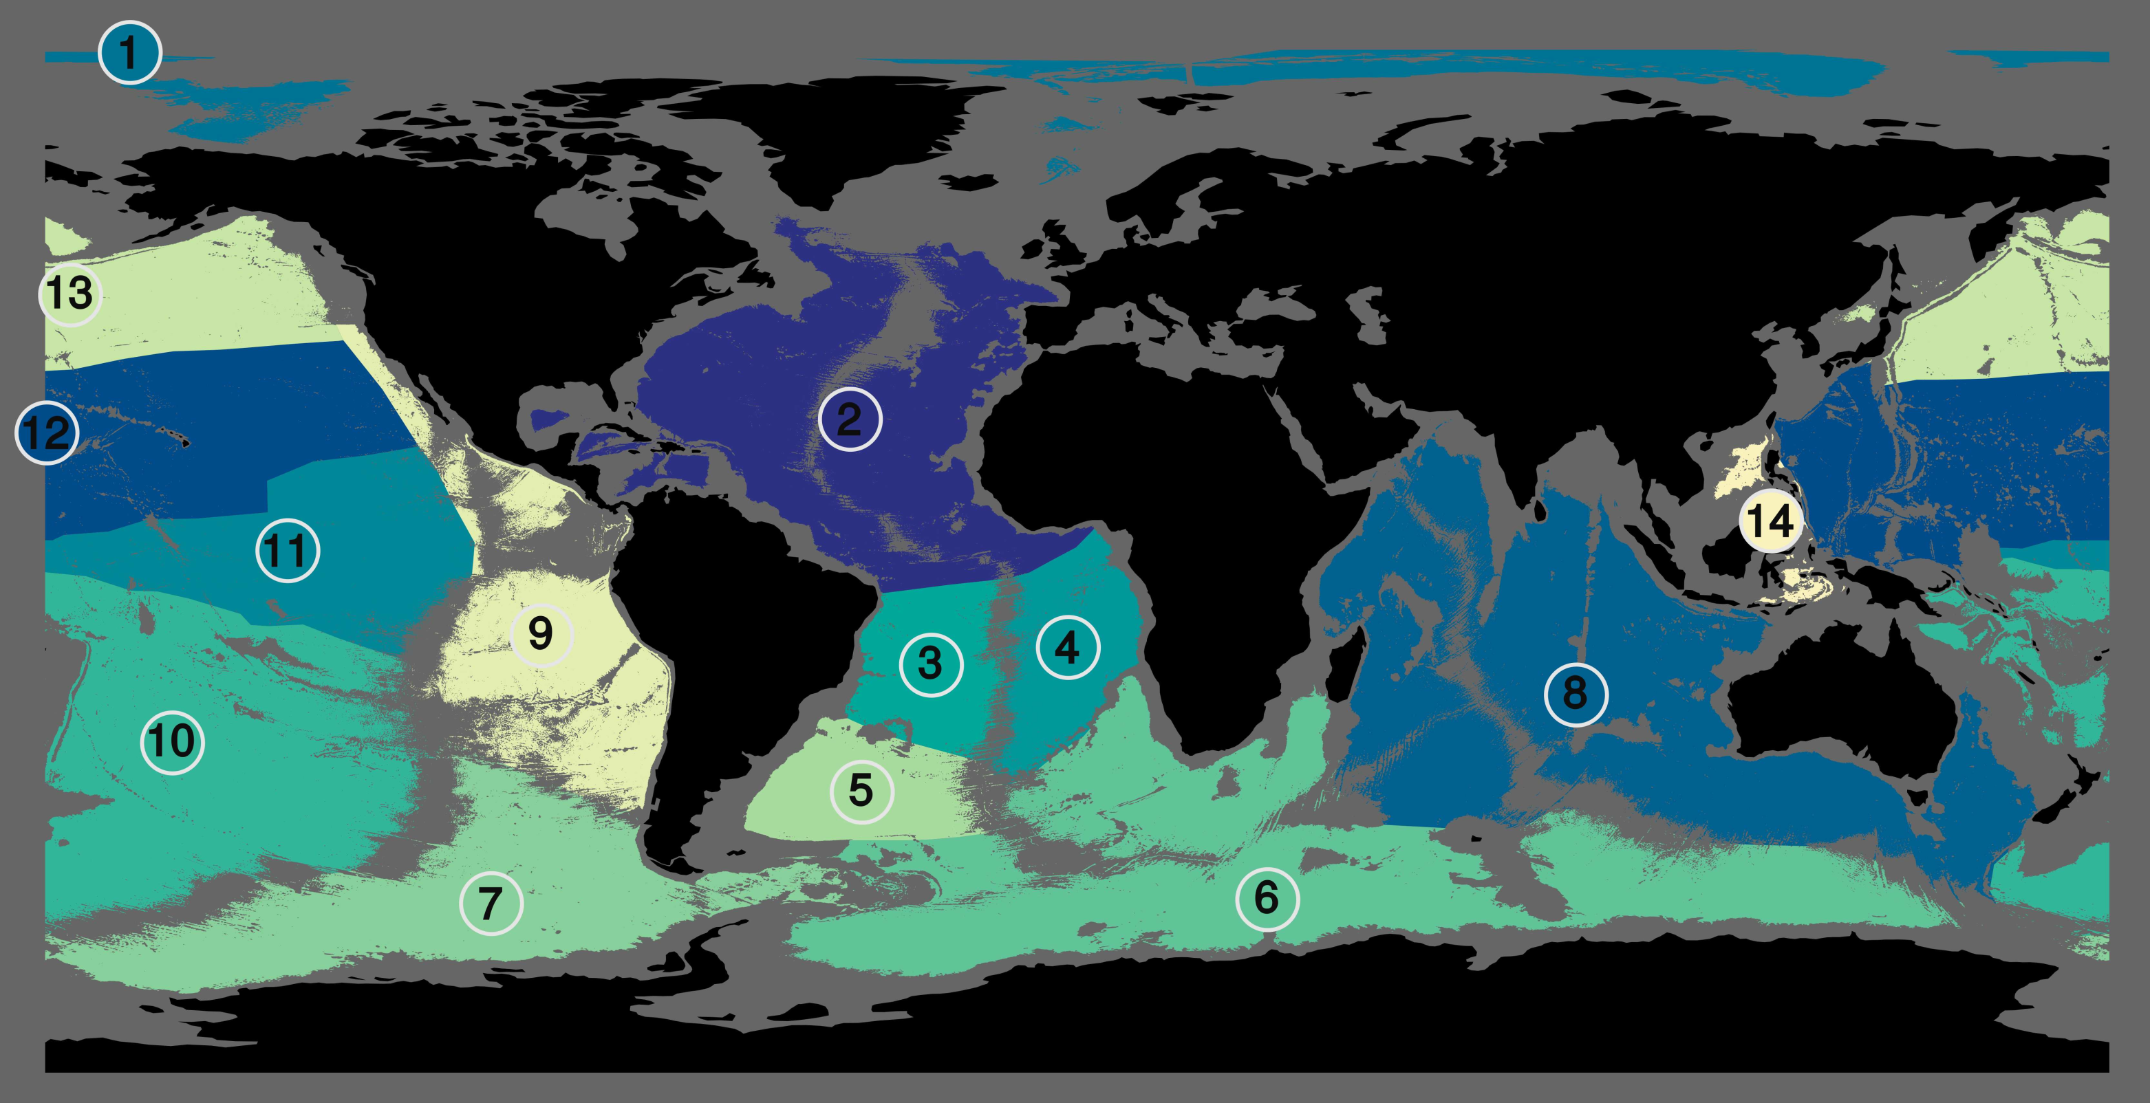
Abyssal Provinces

Slide 11
Biological Data
Census of the Diversity of Abyssal Marine Life - CeDAMar
Unpublished
Working Species
Individuals per species
Secondary factors

Slide 12
Biological Data
Global Biodiversity Information Facility – GBIF
Published version of CeDAMar
Error free
Better spatial coverage
Occurrence only

Slide 13
GBIF & CeDAMar Unique values:
 | Ocean sites | Abyss sites | Records | Phyla | Class | Order | Family | Genera | Species
CeDAMar | 2420 | 657 | 25091 | 21 | 48 | 153 | 528 | 1418 | 6580*
GBIF | 5024 | 1776 | 4942 | N/A | 19 | 56 | 296 | 893 | 2892

Slide 14
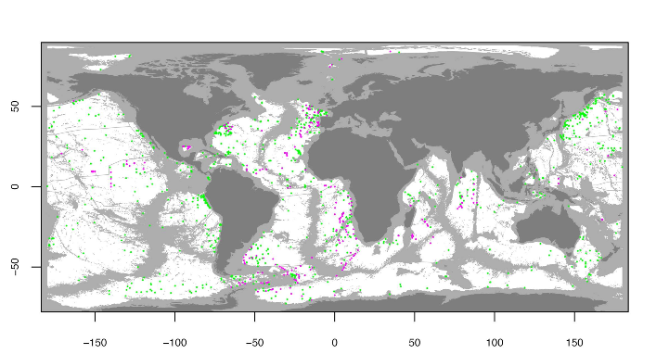
Total Abyssal Sites: GBIF & CeDAMar

Slide 15
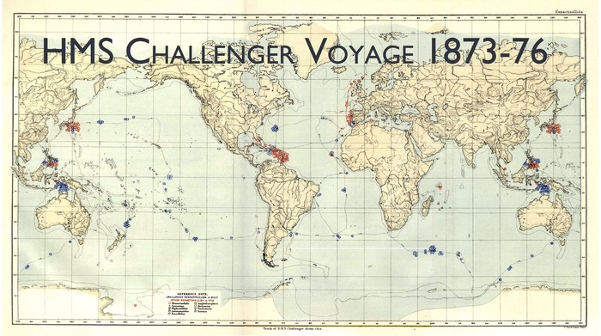
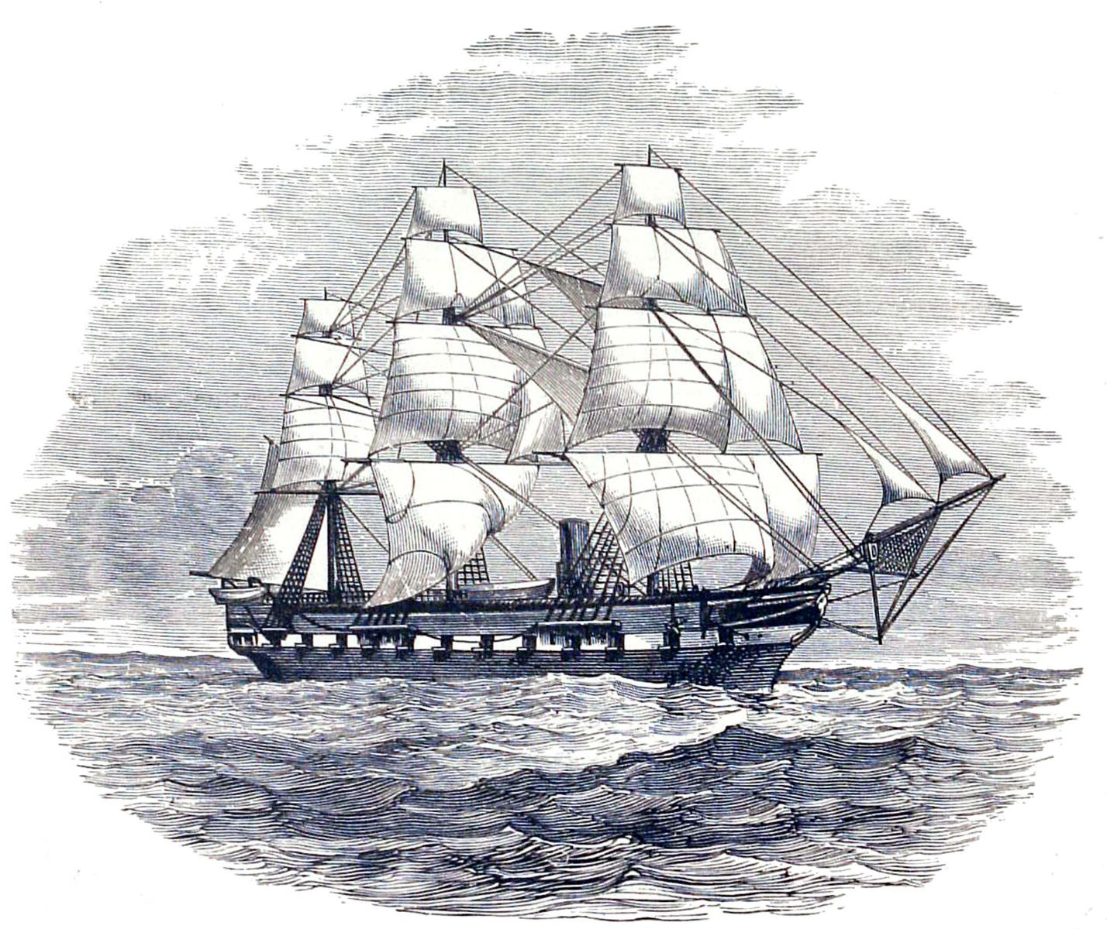
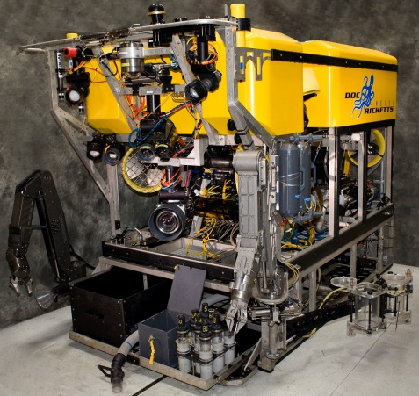

Slide 16
Non Independence: Gear ~ Taxa
Phyla, Class, Order, Family
Camera/video, Corer, Dredge, Grab, Hook and Line, Manual/robotic collection, Sled, Trap, other

Slide 17
Non Independence: Gear ~ Taxa
Phyla, Class, Order, Family
Camera/video, Corer, Dredge, Grab, Hook and Line, Manual/robotic collection, Sled, Trap, other
Basic test: Chi-squared
General fit
Outliers (e.g., Hagfishes, Manual/robotic collection) – limited numbers
P-values < 2.2×10⁻¹⁶
Notes:
To do: densities or idndividuals.

Slide 18
Class
Lower Taxonomic rank:
Sp. ID confidence
Gear selectivity
Higher Taxonomic rank:
Spatial coverage / # of sites
Diversity representation

Slide 19
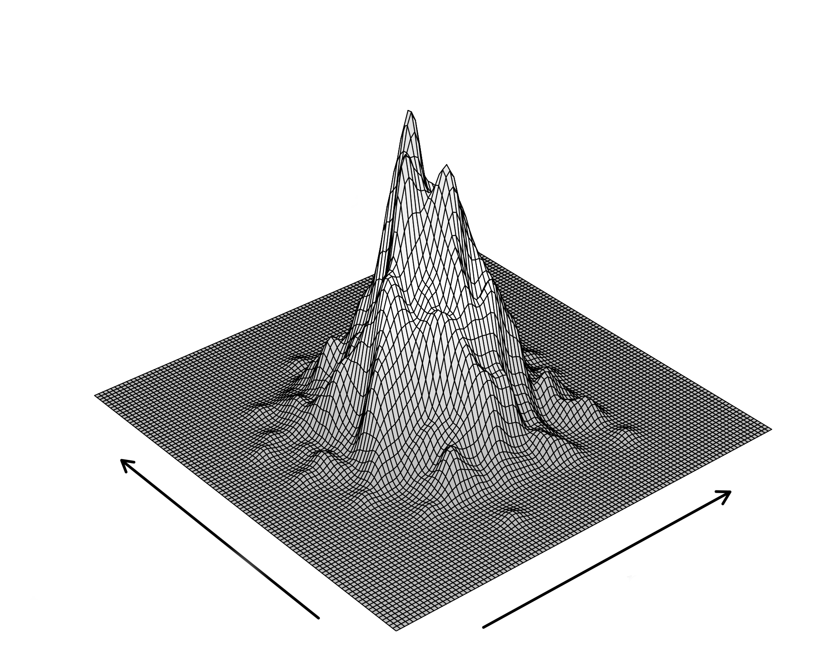
Mid Domain Effect

Slide 20
Testing for MDE with Rarefaction
Class replicate per province:
Species – CeDAMar: Geometric mean [ E(S₁₀₀) + E(S_{median +1}) + E(S_{max inds}) ]
Genera – GBIF: Geometric mean [ E(G₁₀₀) + E(G_{median +1}) + E(G_{max species}) ]

Slide 21
Rarefaction ~ Distance from province centroid
Linear regressions (scalar)
- slopes = MDE
+ slopes= Anti MDE

Slide 22
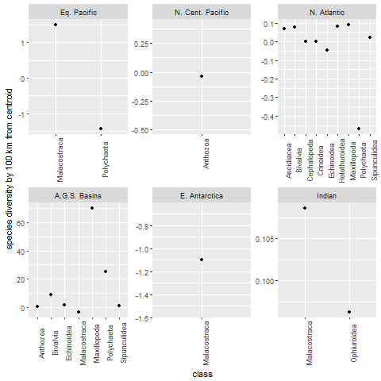
CeDAMar MDE 22 Significant 30 Non-Sig. 8 MDE 14 Anti - MDE

Slide 23
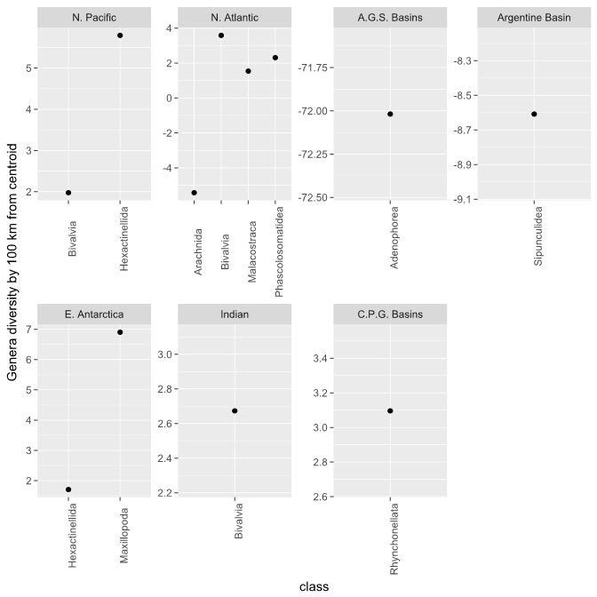
GBIF MDE 12 Significant 57 Non-Sig. 3 MDE 9 Anti - MDE

Slide 24
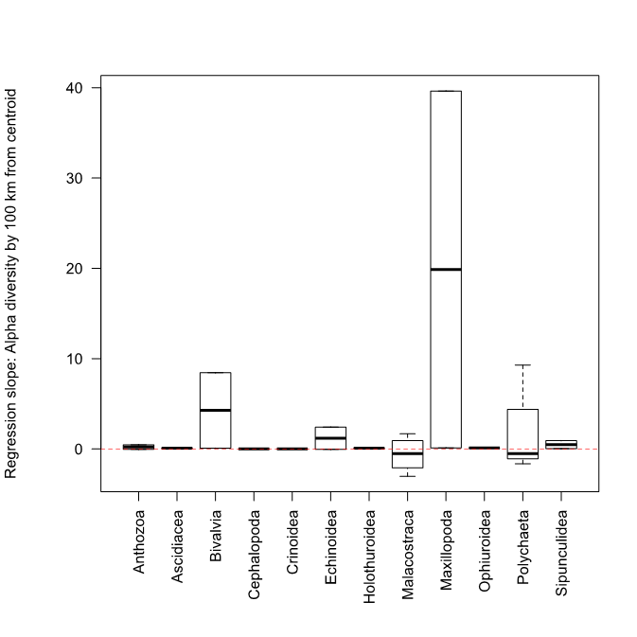
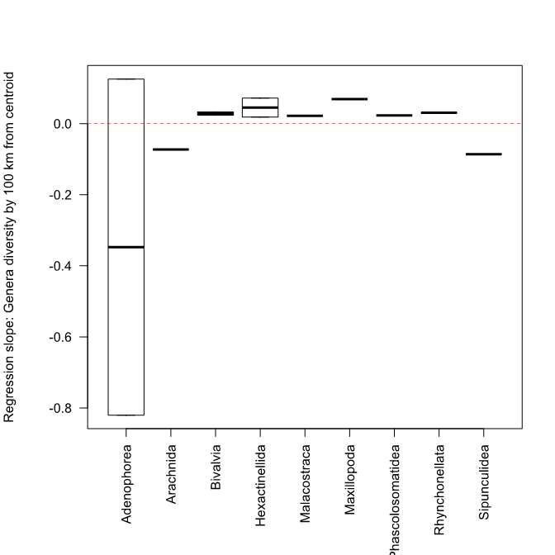
CeDAMar GBIF

Slide 25
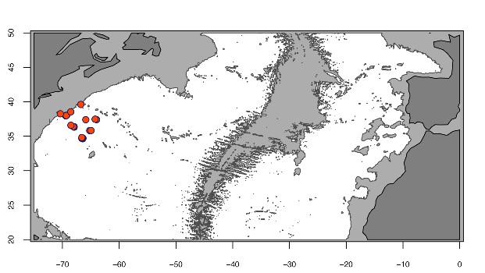
Case study: Landscape scale/province borders

Slide 26
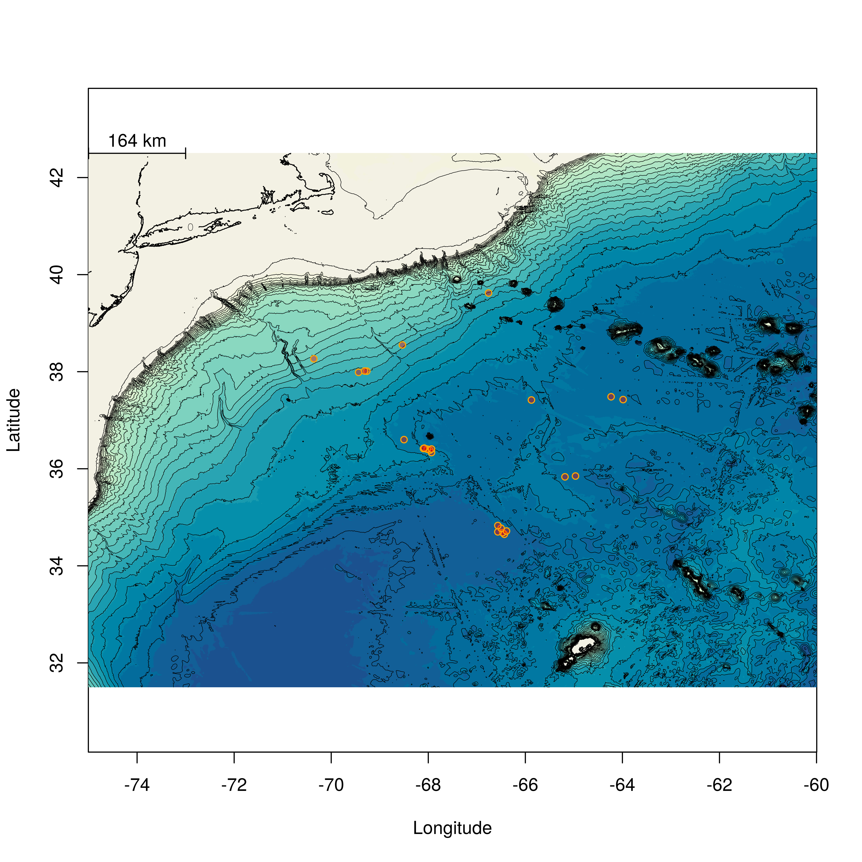
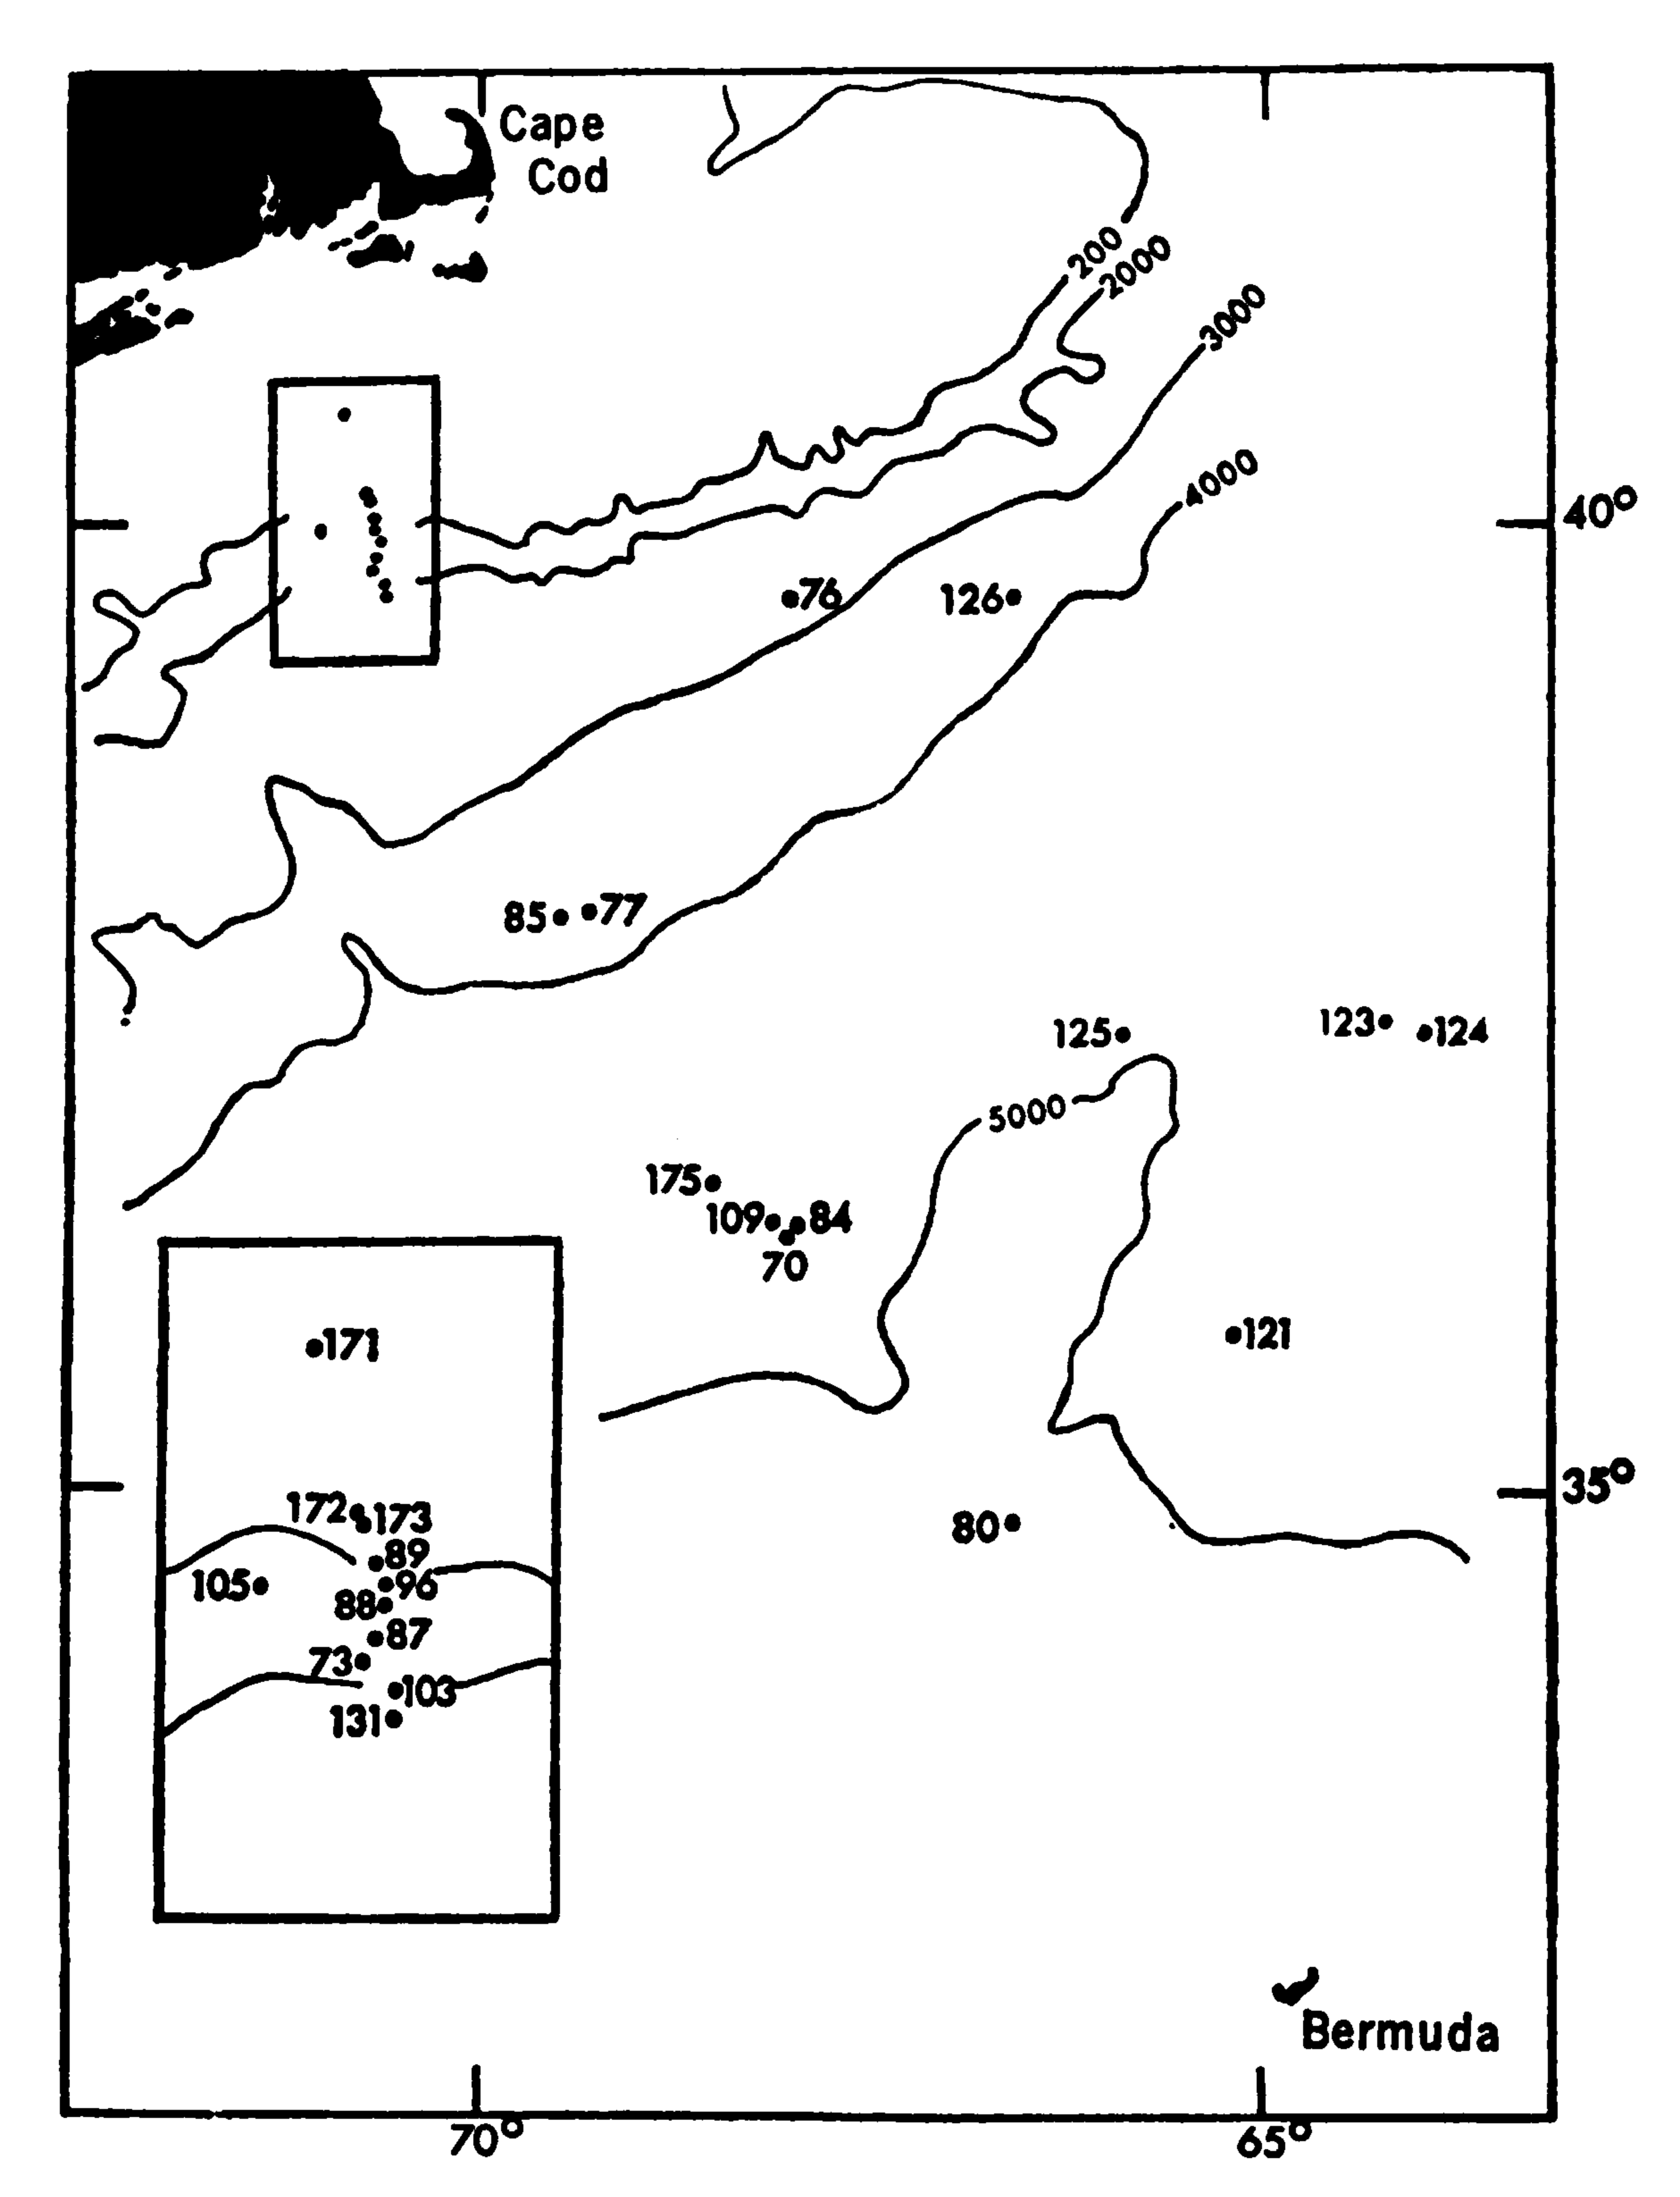
Rex, Michael A. "Deep-sea species diversity: decreased gastropod diversity at abyssal depths." Science 181.4104 (1973): 1051-1053.

Slide 27
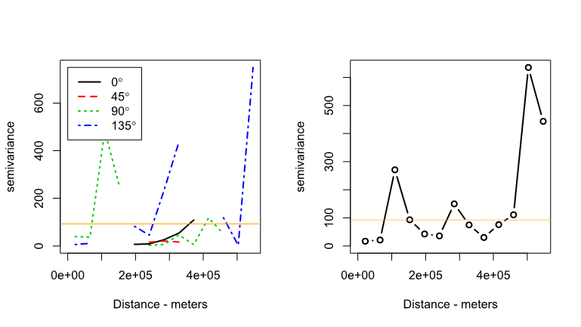
Diversity directional variogram Diversity omnidirectional variogram

Slide 28
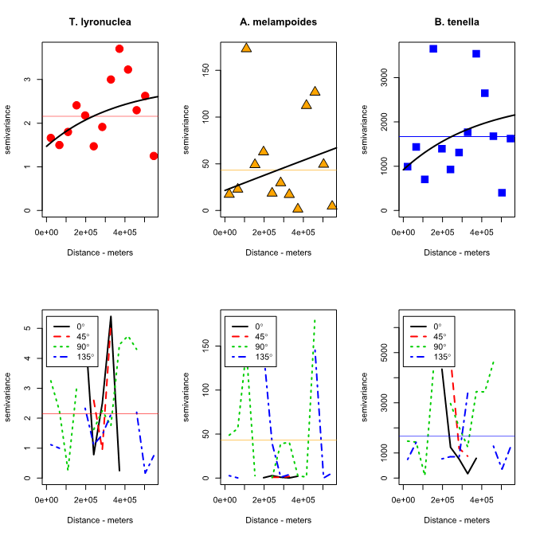
Abundance variograms
3 randomly selected species
Variance by 3 orders of magnitude

Slide 30


Slide 31
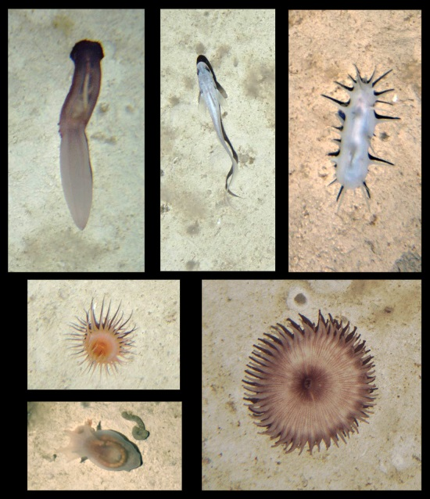
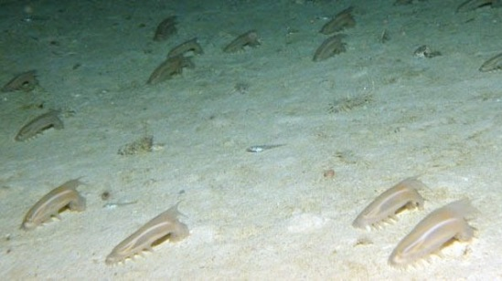
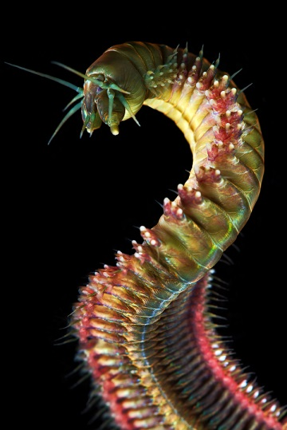
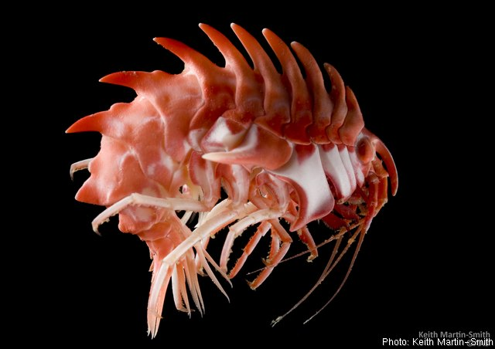
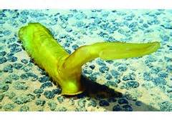
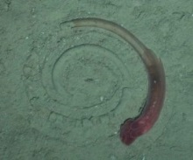
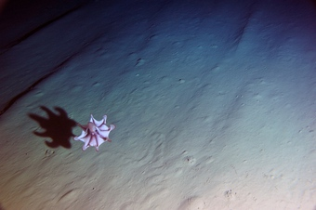
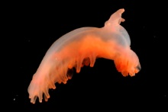
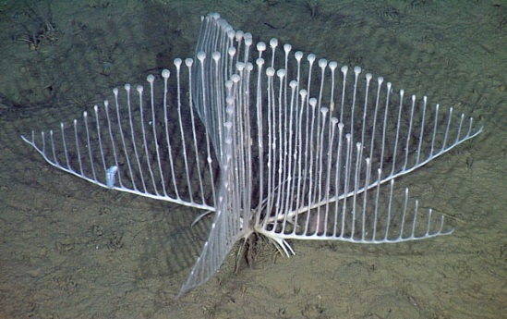
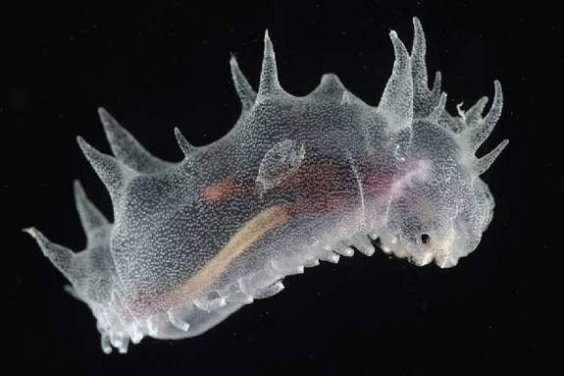
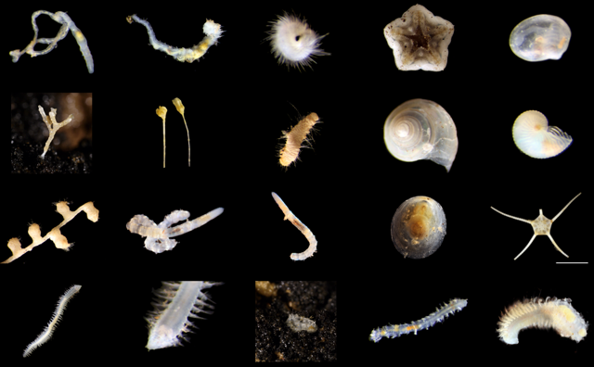
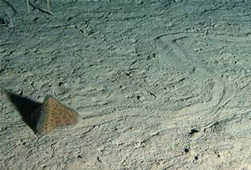
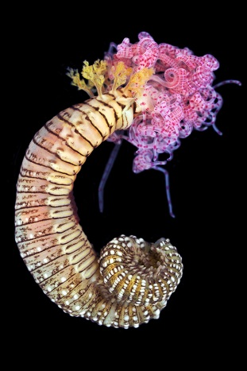
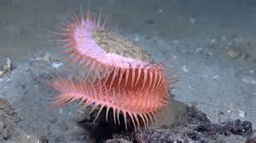
Questions
Questions? bmgenco@gmail.com https://github.com/bmgenco/thesis

